Slide 1
Geologic Time

Slide 2
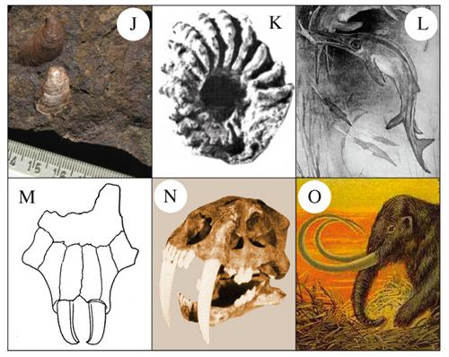
Scientists have learned much about Earth’s past by studying Fossils
Ichthyosaur (resembled fish & dolphins) (Cretaceous)
Ammonite (nautilus) (Cretaceous)
Clam (Jurassic)
Beaver Skull (Miocene)
Saber-toothed cat (Pleistocene)
Woolly Mammoth (Pleistocene)

Slide 3
What are Fossils?
The remains/TRACE of an organism that was once alive

Slide 4
Fossils help us to:
See what an organism looked like when it was alive
See when, where and how an organism once lived
Determine when life on Earth began and what type of organisms lived in the past

Slide 5
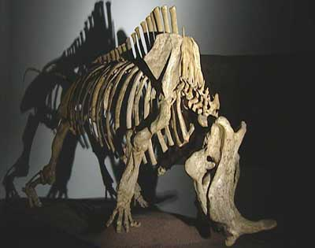
How do fossils form?
When an animal dies, soft tissue is eaten away by scavengers and decomposed by bacteria
Only the hard
parts remain

Slide 6
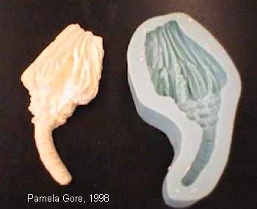
Mold and Cast Fossil
-A mold is an impression of a bone,
shell, etc.
-A cast is created
when the mold is
filled in
-Similar to making
chocolates from a mold

Slide 7
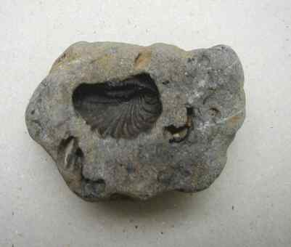
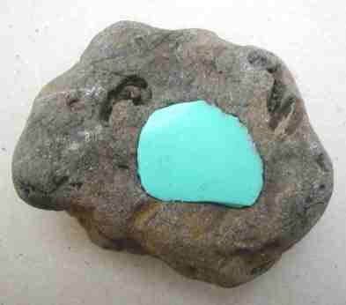
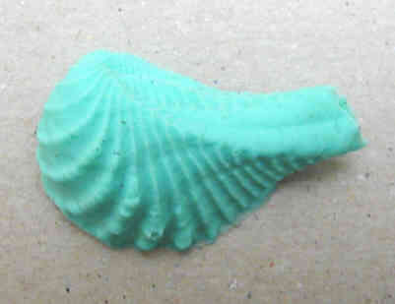
Mold & Cast Formation

Slide 8
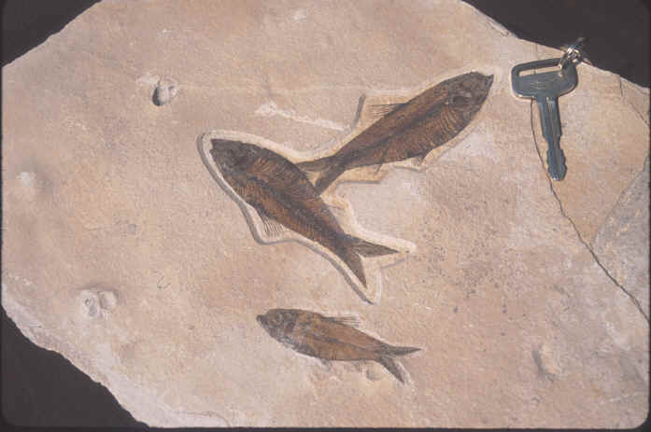
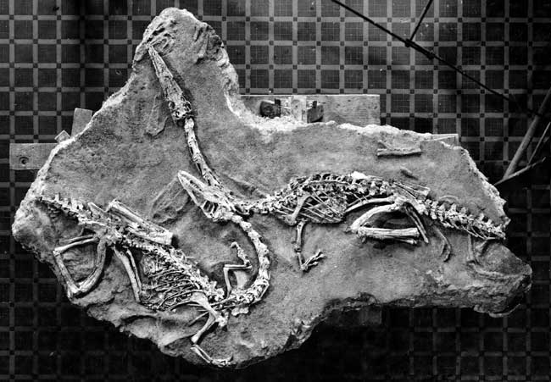
Replacement of Minerals
Water dissolves the remains of an organism and leaves minerals in its place

Slide 9
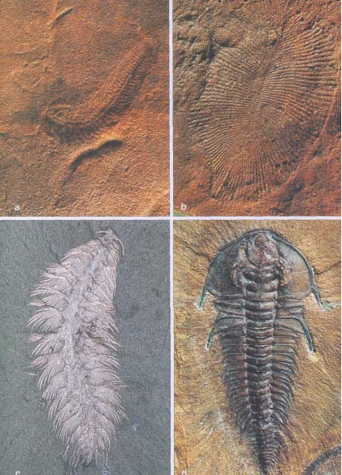

Slide 10
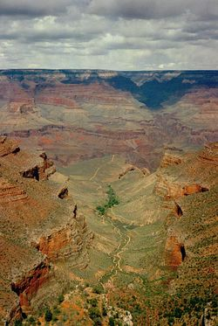
Scientists also use fossil and rock evidence to determine how and when different areas of Earth formed.
Example:
The Grand Canyon

Slide 11
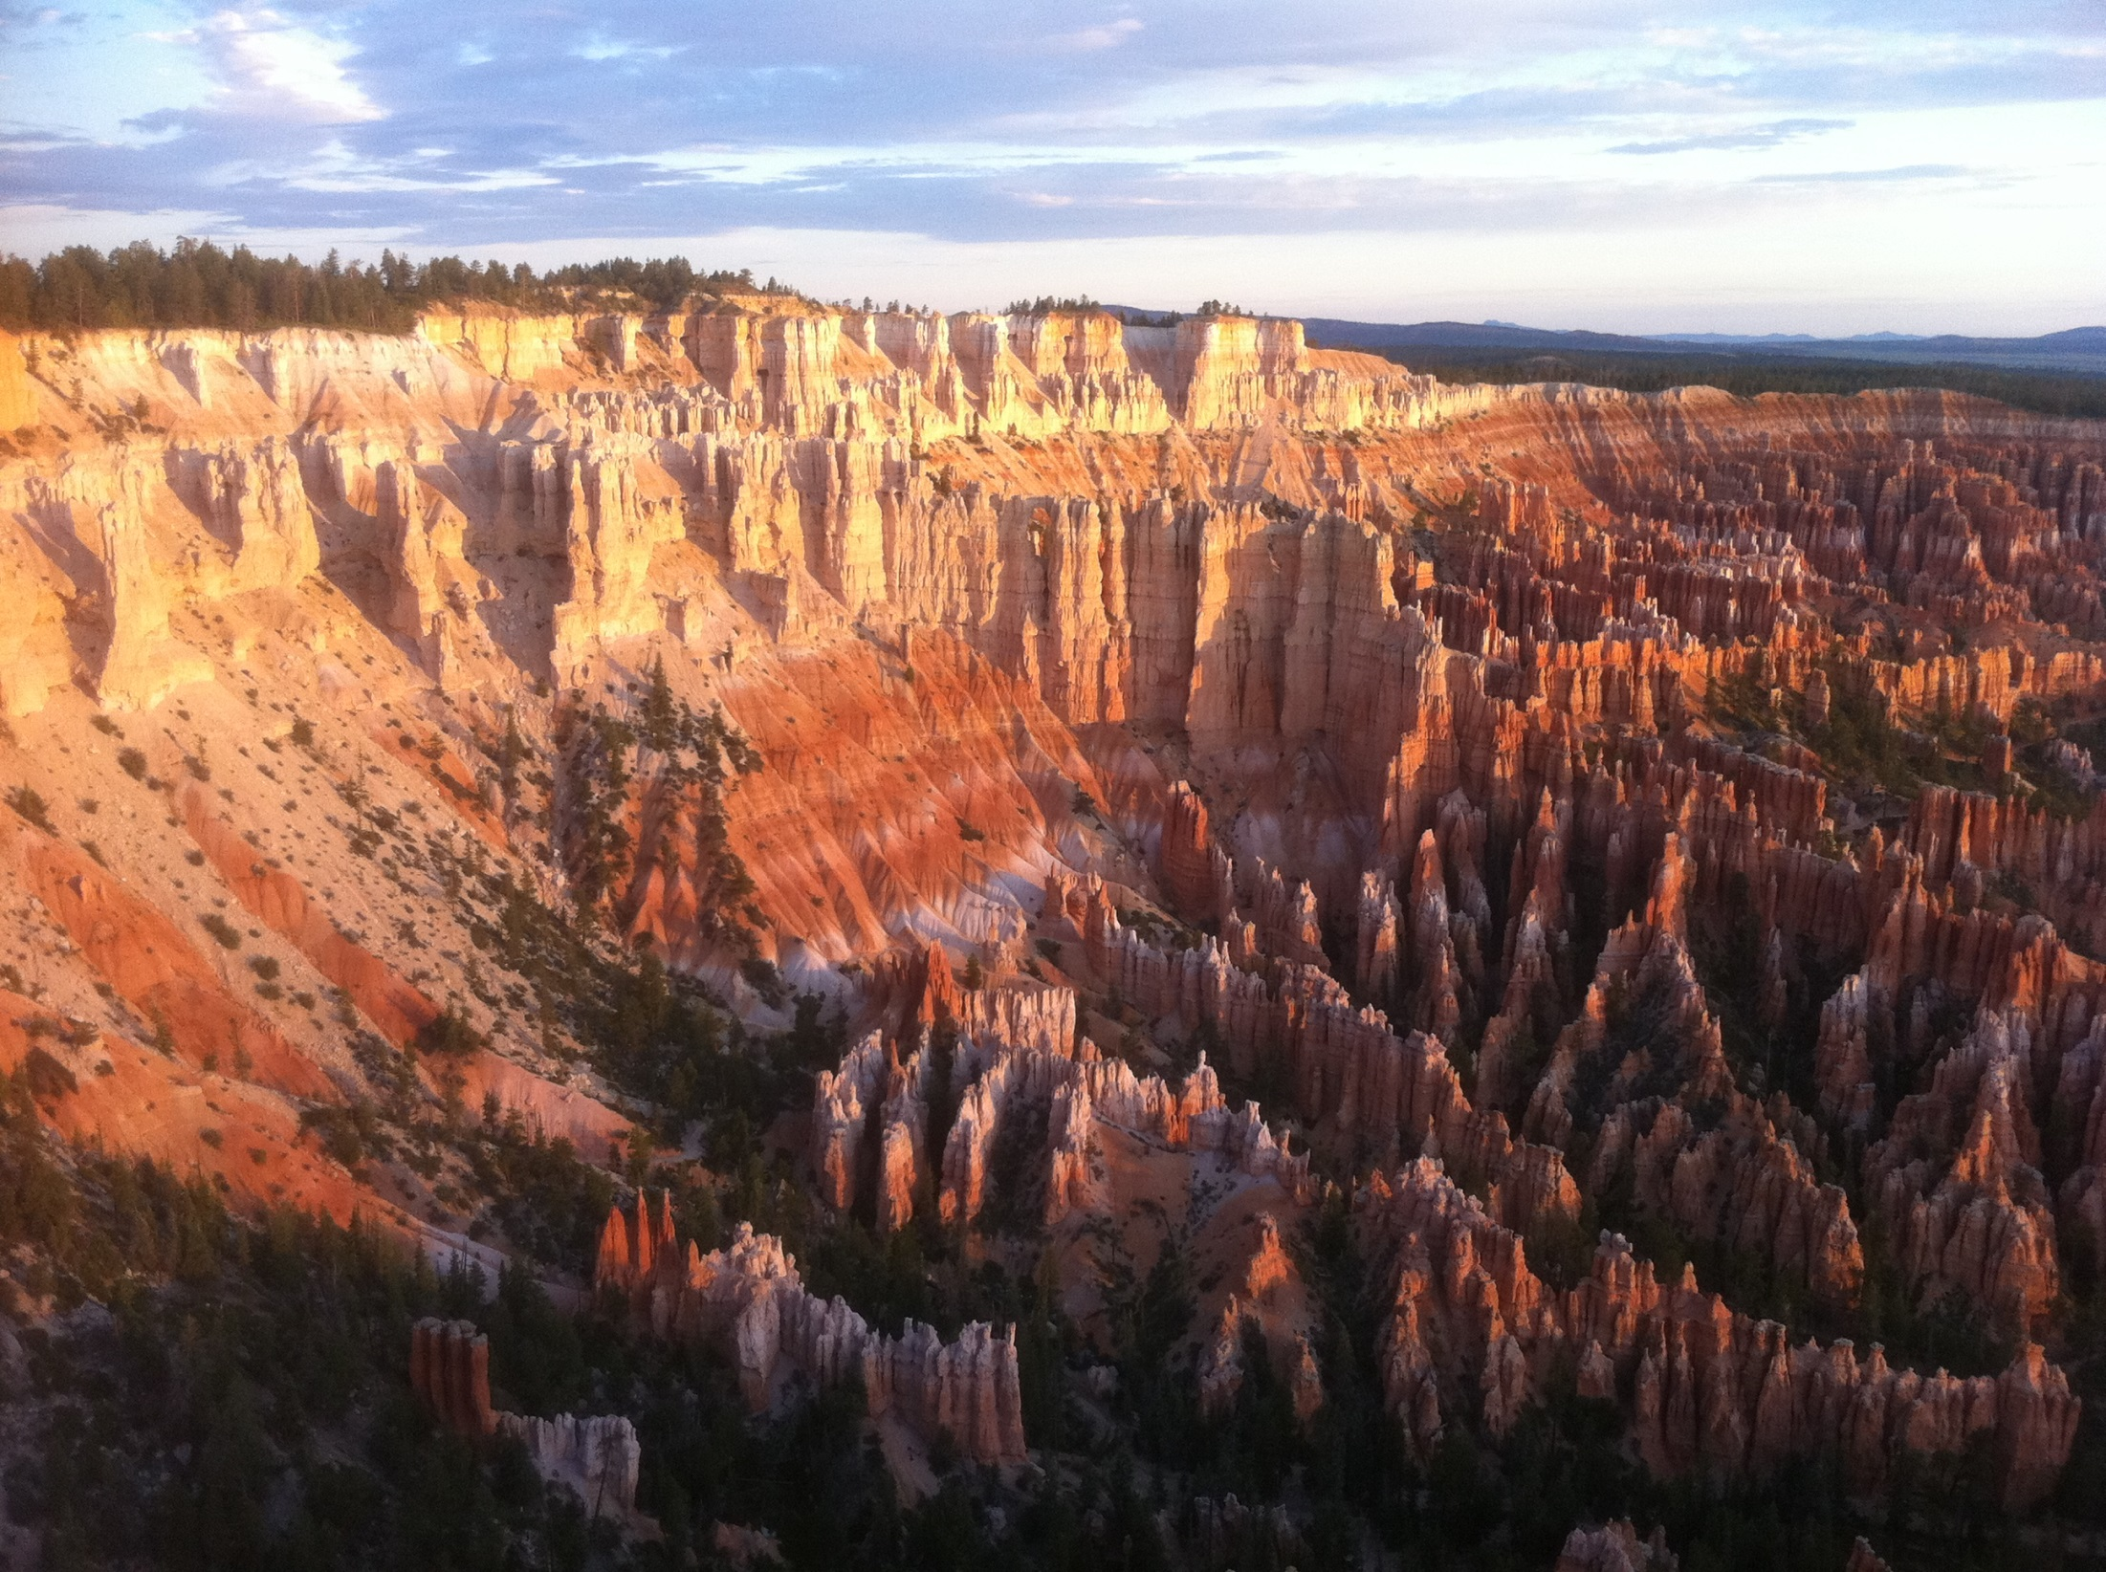

Slide 12
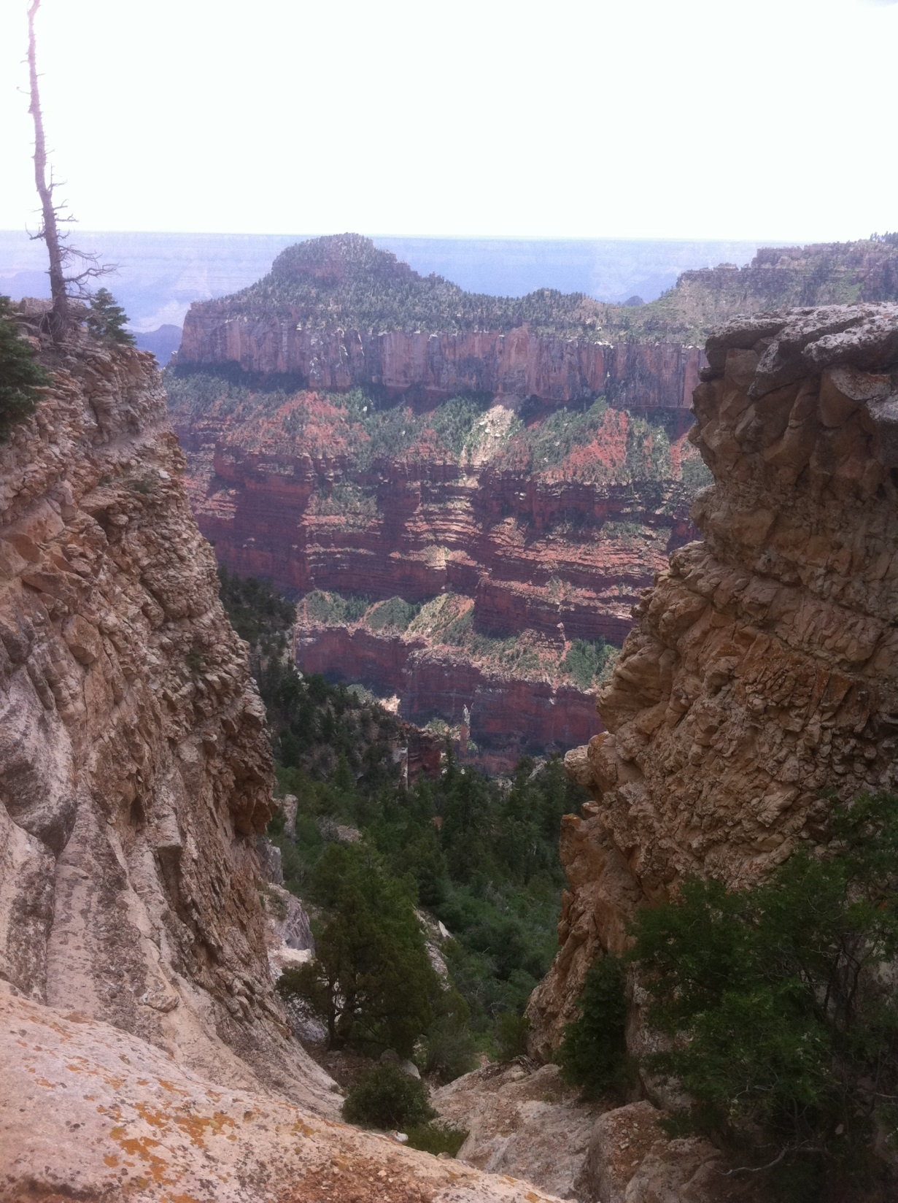
The North Rime

Slide 13
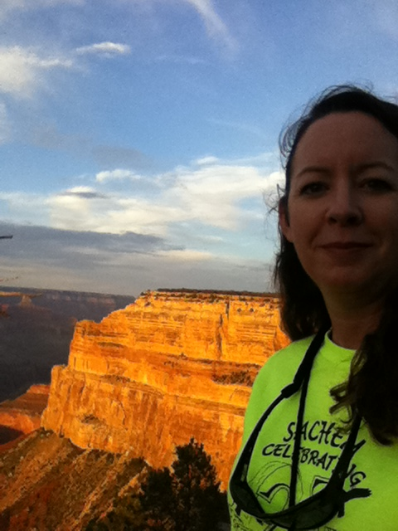

Slide 14
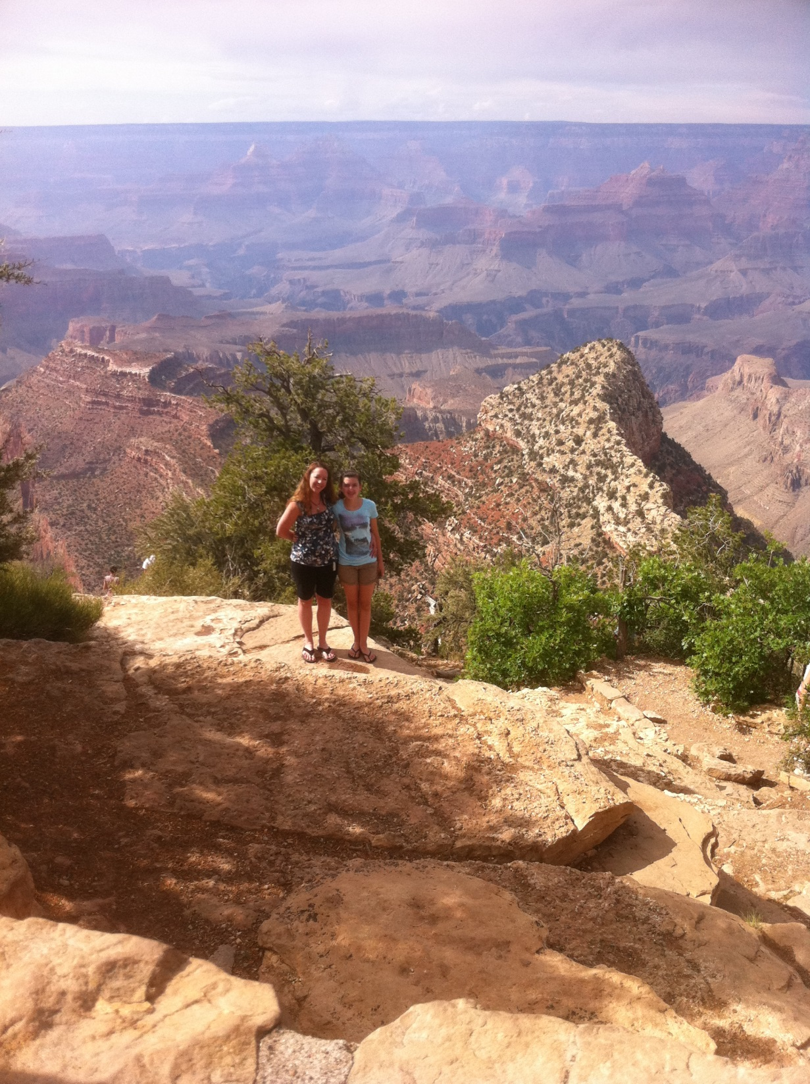

Slide 15
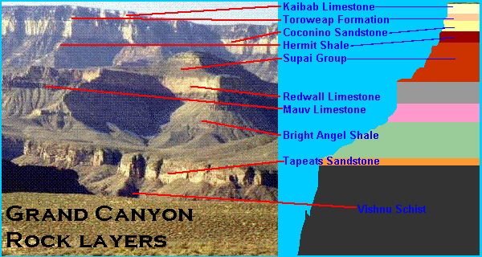

Slide 16
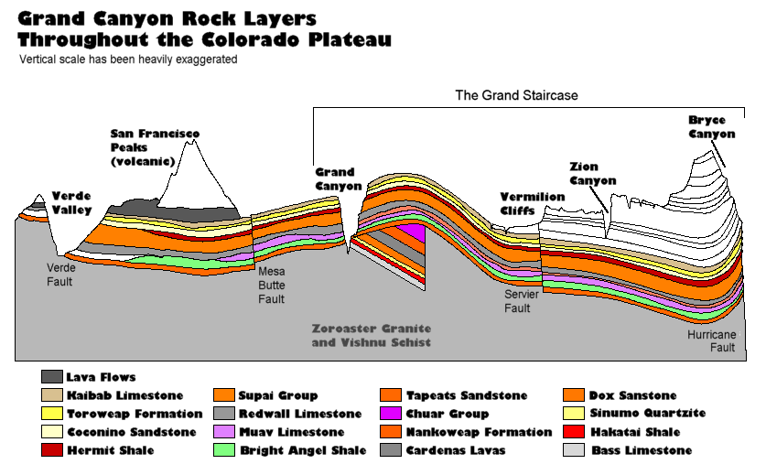

Slide 17
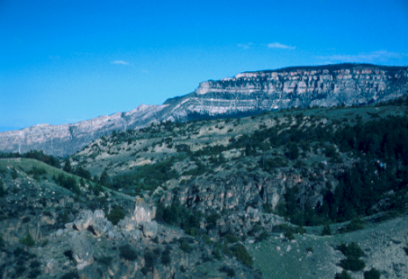
Rules of Geology
1. The Law of Original Horizontality
All rock layers are originally
deposited HORIZONTALLY

Slide 18
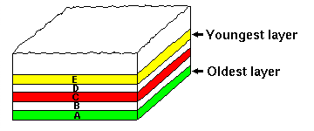
2. The Principle of Superposition
In rock layers, the oldest layers are at
the bottom and the youngest layers are
at the top
(if the layers have not been disturbed)

Slide 19
What can disturb rock layers?
Earthquakes, volcanic eruptions and mountain building can cause folding, tilting and faulting

Slide 20
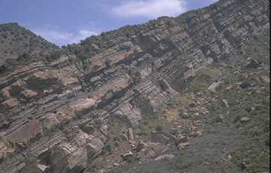
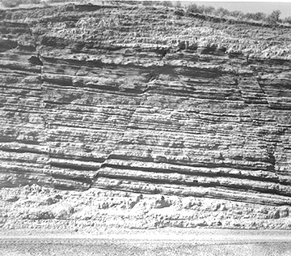
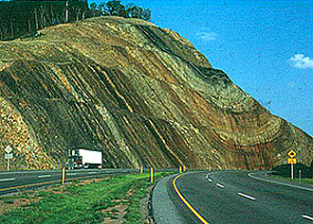
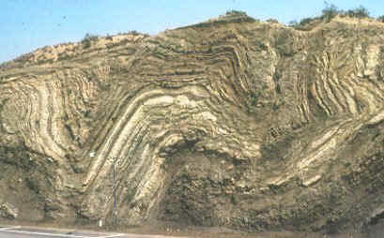
DISTURBED ROCK LAYERS
Tilting
Faulting
Folding

Slide 21
Unconformities
-A missing layer of rock that shows a GAP in geologic time
Unconformities are caused by erosion of rock layers

Slide 22
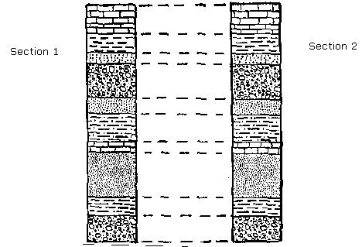
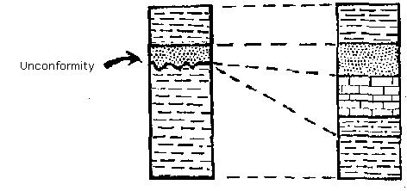

Slide 23
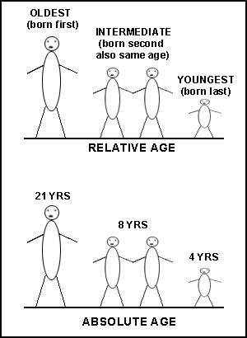
When a fossil is found in
a rock layer, scientists
can tell the age of the
rock by determining the
Relative Age
(approximate age) of the
fossil
**The rocks MUST be the same age as the fossil found in them

Slide 24
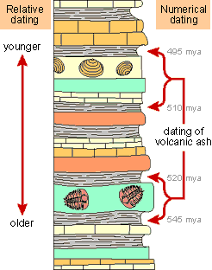

Slide 25
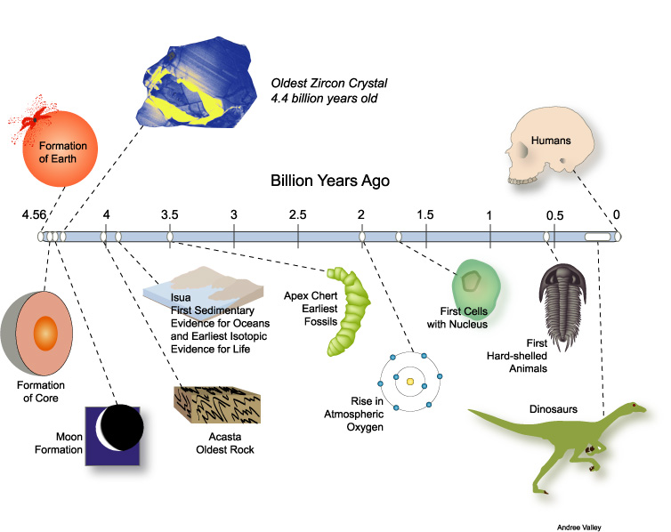
Scientists use fossil and rock evidence to organize events in Earth’s past into a timeline

Slide 26
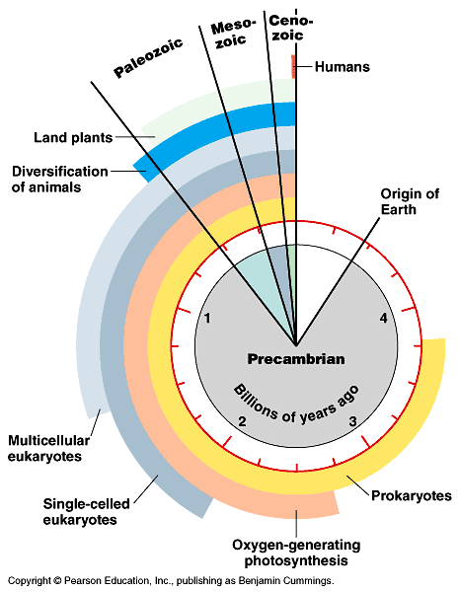

Slide 27
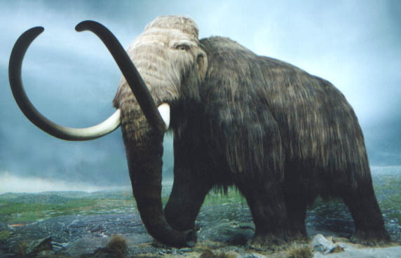
Early Earth History
Earth is about 4.6 billion years old
Geologic features, climate, plant and animal life have constantly changed over this time

Slide 28
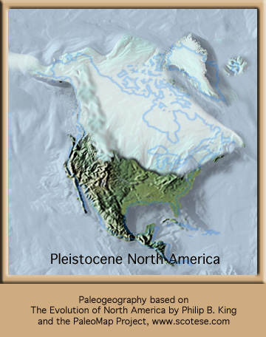

There is evidence that North America had a tropical climate in the past AND at least 4 major ice ages
1.8 million years ago to 10,000 years ago
About 360 million years ago

Slide 29
The Geologic Time Scale
A chart that shows events that have occurred during Earth’s history
It is broken into lengths of time based on events
There are 4 major divisions on the chart
Three of the four are called Eras: Cenozoic, Mesozoic, Paleozoic
The fourth division is called Precambrian Time

Slide 30
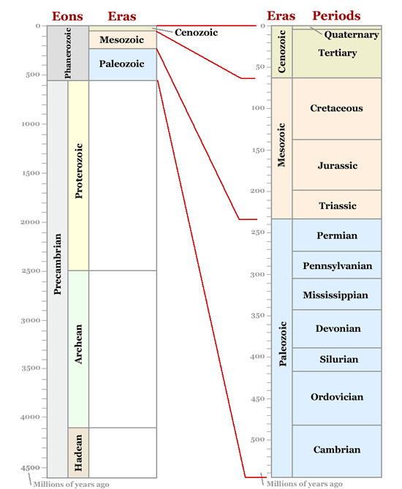

Slide 31
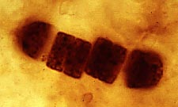
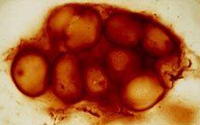
Precambrian Time
Began 4600 million years ago and ended 540 million years ago
Makes up 88% of earths history to date
Very little info. is available about life during this time
The dominant form of life was cyanobacteria, which added oxygen to the atmosphere
850 million year old Cyanobacteria preserved in rock

Slide 32

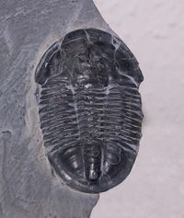
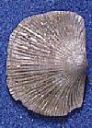
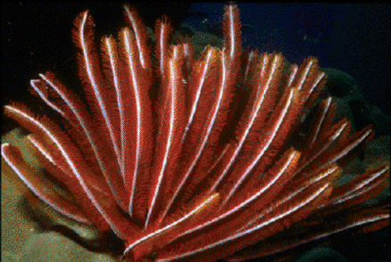
Paleozoic Era
Began 544 million years ago
Provided us with the 1st fossils from organisms with hard parts
Earth was covered with warm, shallow seas at this time
Therefore, most life forms were marine organisms
Ex. Trilobites (relative of the horseshoe crab), Brachiopods (similar to clams) and Crinoids (relative of starfish)

Slide 33
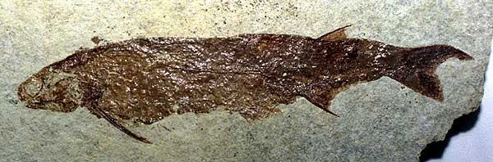
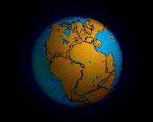
During the Paleozoic Era
The 1st fish evolved in this era
Pangaea (a giant landmass) formed near the end of the era
**A mass extinction of many marine organisms occurred at the end of this era due to climate changes

Slide 34
Mesozoic Era
Began after the Paleozoic Era ended
This was “The Age of Dinosaurs”
The 1st mammals, birds and flowering plants appeared during this era
Pangaea breaks up during this era

Slide 35
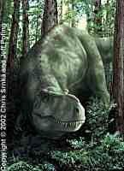
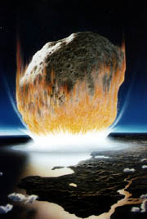
At the end of the Mesozoic Era there was a mass extinction of the dinosaurs

Slide 36
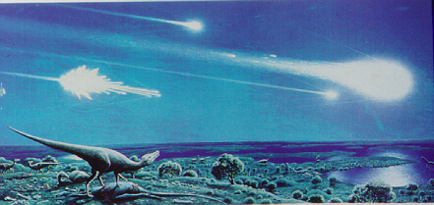
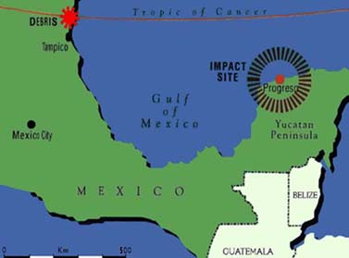
Theories about what happened to the dinosaurs?
1. An impact with an asteroid blocked Earth’s atmosphere from receiving sunlight and:
    a. Changed the food chain
    b. Created major climate changes
2. Gradual natural changes
in the environment occurred
3. Increased volcanic
eruptions sent ash
and soot into the
atmosphere
4. Disease killed them

Slide 37
Cenozoic Era
-The Alps and Himalayas formed
-Flowering plants, insects and mammals increased
-1st humans appeared 500,000 years ago
-Humans became a dominant animal only 10,000 years ago!!

Slide 38
Years ago | Event
130,000 | Anatomically modern humans evolve. Seventy thousand years later, their descendents create cave paintings — early expressions of consciousness.
4 million | In Africa, an early hominid, affectionately named "Lucy" by scientists, lives. The ice ages begin, and many large mammals go extinct.
65 million | A massive asteroid hits the Yucatan Peninsula, and ammonites and non-avian dinosaurs go extinct. Birds and mammals are among the survivors.
130 million | As the continents drift toward their present positions, the earliest flowers evolve, and dinosaurs dominate the landscape. In the sea, bony fish diversify.
225 million | Dinosaurs and mammals evolve. Pangea has begun to break apart.
248 million | Over 90% of marine life and 70% of terrestrial life go extinct during the Earth's largest mass extinction. Ammonites are among the survivors.
250 million | The supercontinent called Pangea forms. Conifer-like forests, reptiles, and synapsids (the ancestors of mammals) are common.
360 million | Four-limbed vertebrates move onto the land as seed plants and large forests appear. The Earth's oceans support vast reef systems.
420 million | Land plants evolve, drastically changing Earth's landscape and creating new habitats.
450 million | Arthropods move onto the land. Their descendants evolve into scorpions, spiders, mites, and millipedes.
500 million | Fish-like vertebrates evolve. Invertebrates, such as trilobites, crinoids, brachiopids, and cephalopods, are common in the oceans.
555 million | Multi-cellular marine organisms are common. The diverse assortment of life includes bizarre-looking animals like Wiwaxia.
3.5 billion | Unicellular life evolves. Photosynthetic bacteria begin to release oxygen into the atmosphere.
3.8 billion | Replicating molecules (the precursors of DNA) form.
4.6 billion | The Earth forms and is bombarded by meteorites and comets.

Slide 39
The Geologic Time Scale shows the evolution of species
Evolution is the change in a population
over time
Charles Darwin realized that species are always changing (evolution)

Slide 40
Rates of Evolution
Most of the diversity of life is believed to be the result of Natural Selection over a vast period of geologic time.
CHANGES TO THE ENVIRONMENT:
~Minimal Changes results in a
STABLE POPULATION
~Rapid Changes results
in RAPID CHANGES IN SPECIES

Slide 41
Two models for the rate of evolution:
Gradualism: a slow and steady change over time
Punctuated Equilibrium: long stable periods interrupted by brief periods of more rapid change.
  Punctuated Equilibrium is supported by the mass extinctions that we know have occurred in history.

Slide 42
  Punctuated Equilibrium is supported by the mass extinctions that we know have occurred in history.
~245 million years ago, 95% of all animals/plants disappeared
~145 million years ago another mass extinction occurred, this one killing all dinosaurs
~1.8 million years ago Earth experienced an ice age

Slide 43
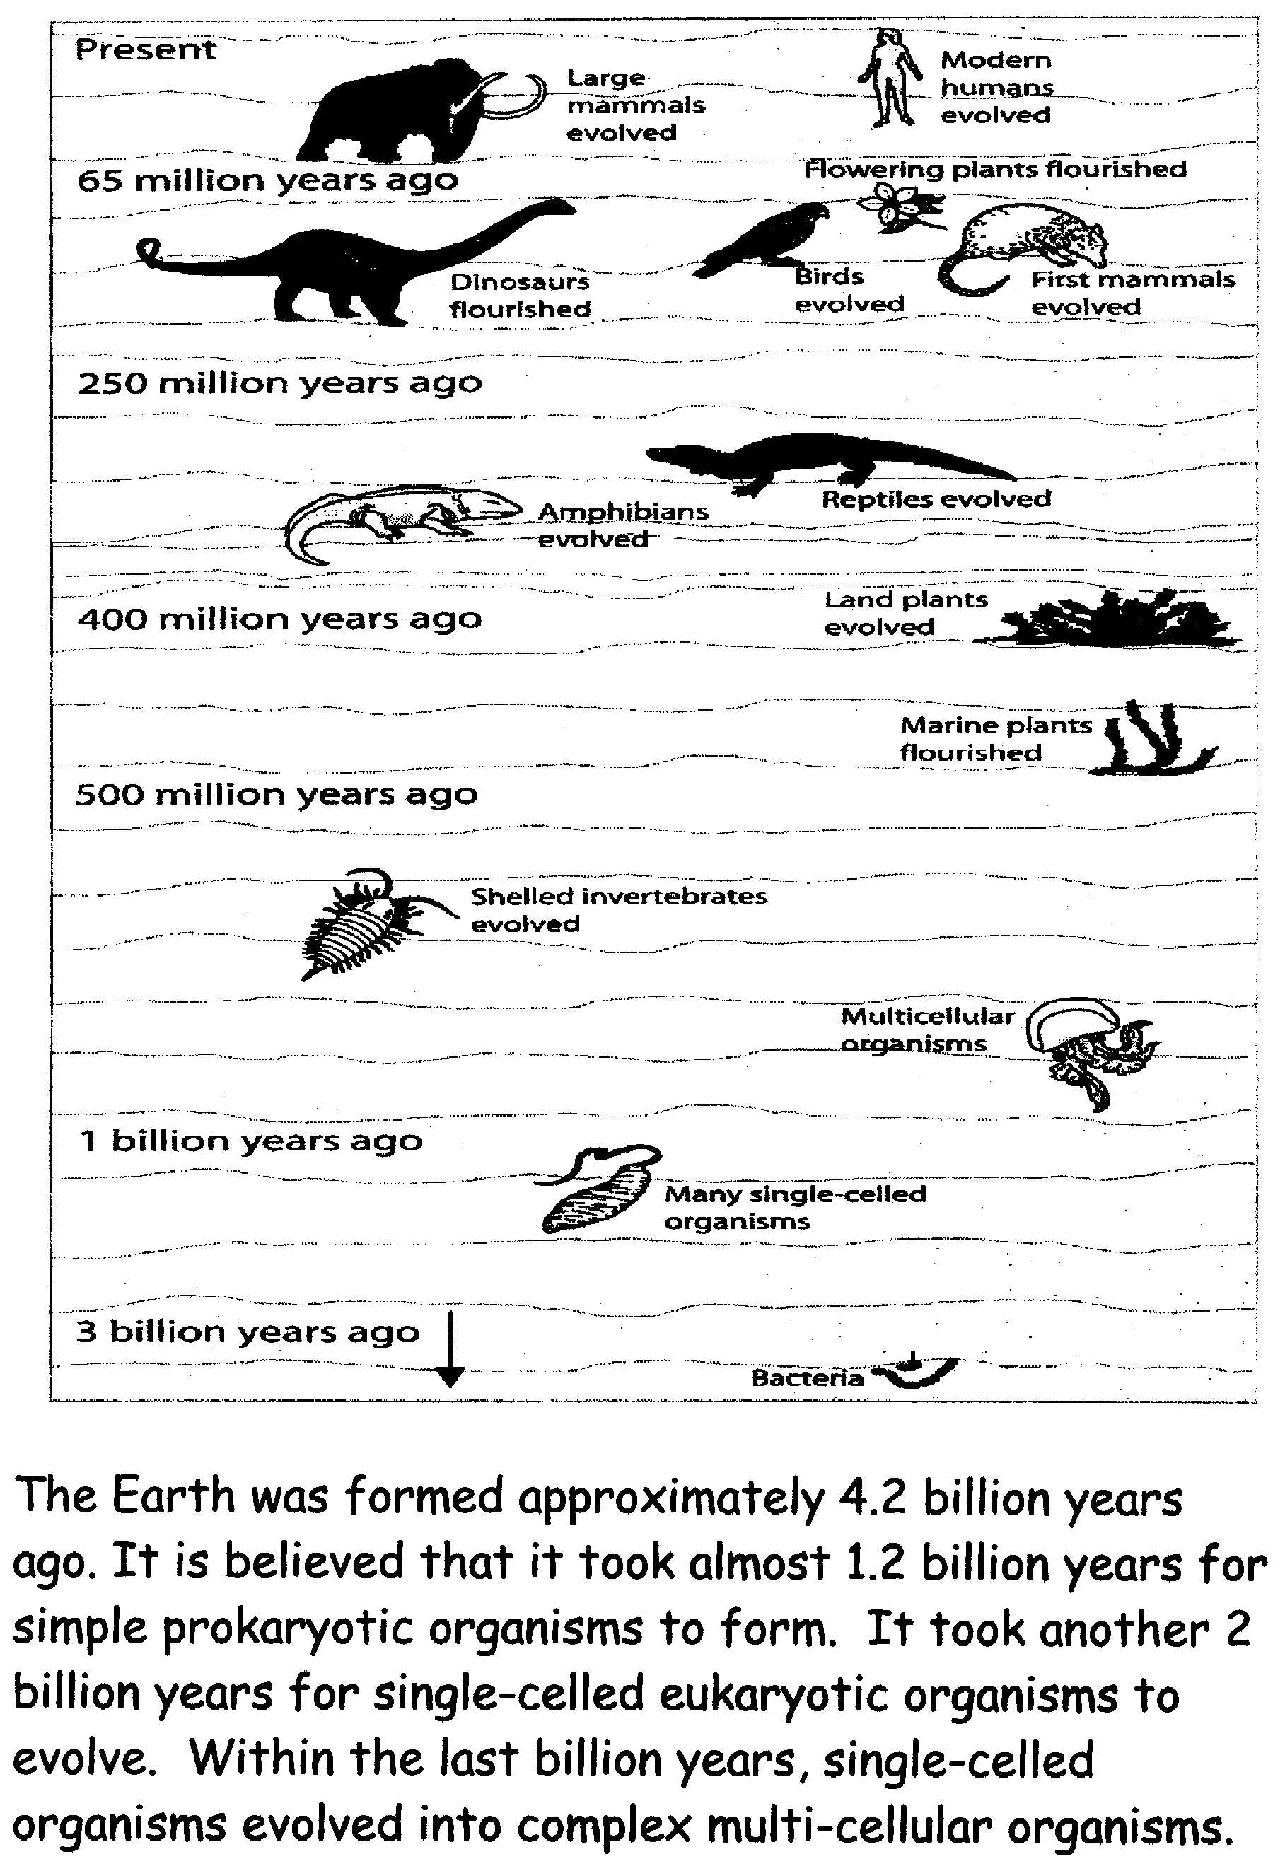

Slide 44
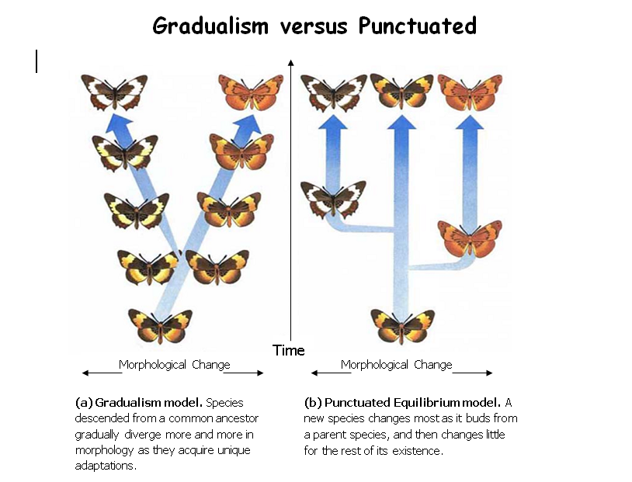

Slide 45
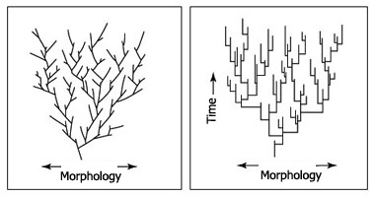
Gradualism v. Punctuated Equilbrium

