Slide 1
4. Variations
Variations: Any difference in traits between individuals of the same species
***Over a long period of time, helpful variations accumulate in a species, while unfavorable ones disappear.
Without VARIATIONS, all the members of a species would have the same traits. Evolution by natural selection would not occur because all individuals would have an equal chance of surviving and reproducing.
ANY TRAIT THAT HELPS AN ORGANISM SURVIVE AND REPRODUCE IS SAID TO HAVE AN ADAPTIVE VALUE.

Slide 2
Remember….this was the 1800s!
Darwin did not know anything about genes or mutations, so he could not explain what caused variations or how they were passed on, but today, we know two major sources of Variations:
  1. “Genetic Shuffling” – random assortment of genes during meiosis and fertilization.
  2. Mutations: (change in the normal DNA sequence)
Nearly all mutations are harmful, but a few mutations can be beneficial to the survival of the organism

Slide 3
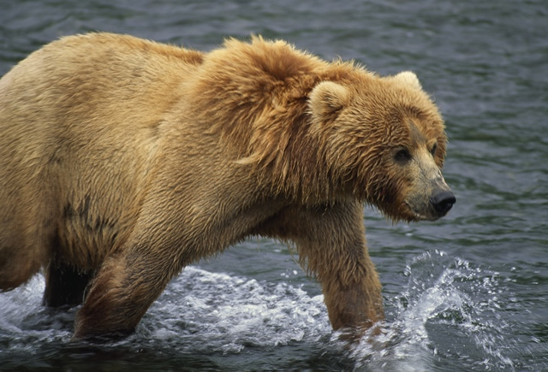
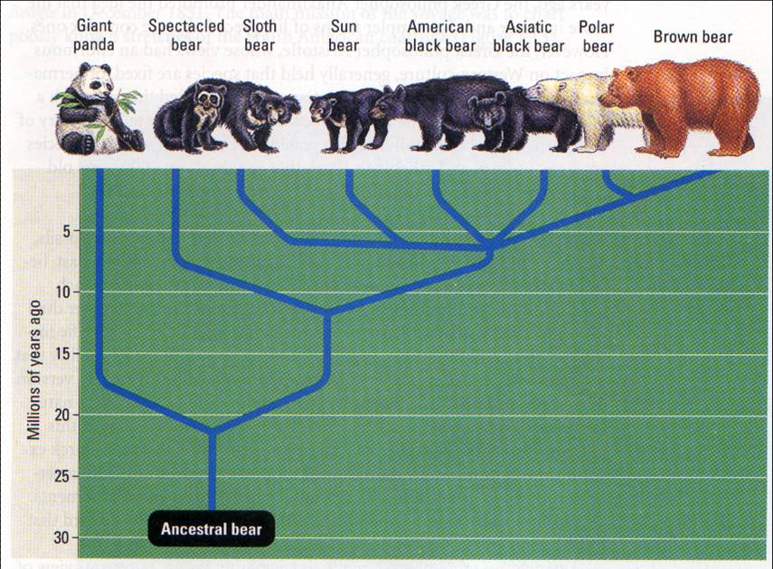
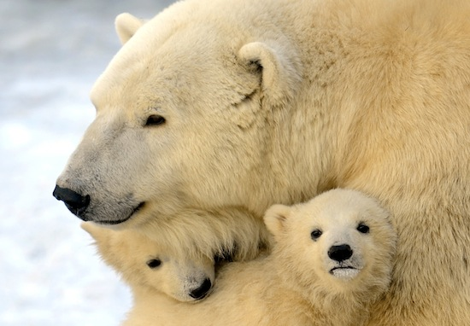
Example: Polar Bears
The allele for fur without color would not be a beneficial adaptation unless the animal lived in an area where the fur would match the environment.

Slide 4
Evidence #1: Fossils
FOSSILS: ARE THE PRESERVED REMAINS OR TRACES OF AN ORGANISM THAT LIVED IN THE PAST
  Most fossils form when organisms that die become buried in sediments.
  * The older the fossil, the deeper it would be buried

Slide 5
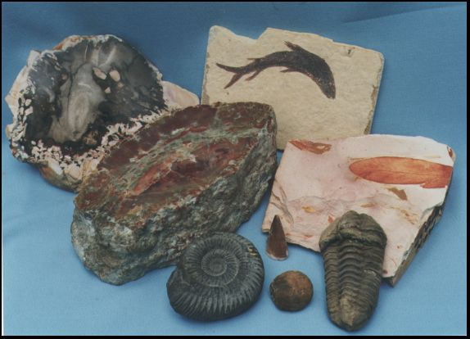

Slide 6
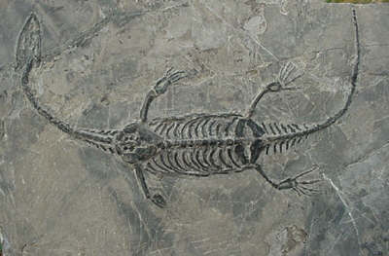
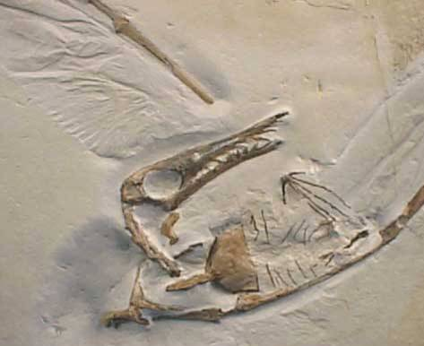
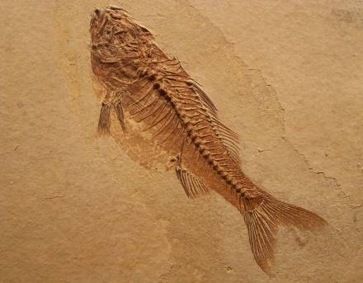

Slide 7
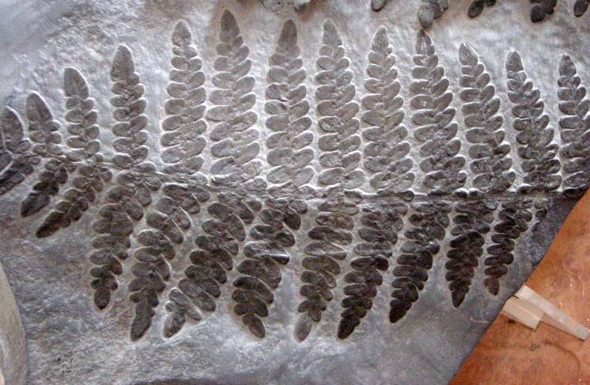
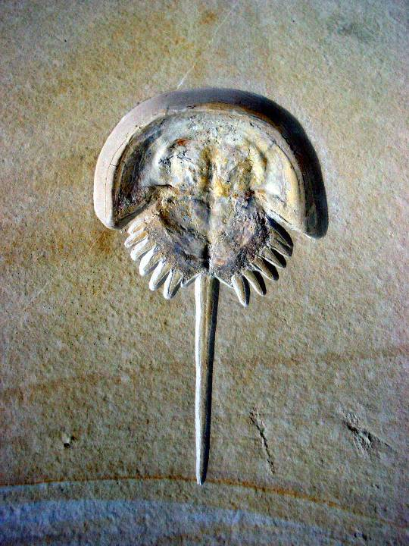
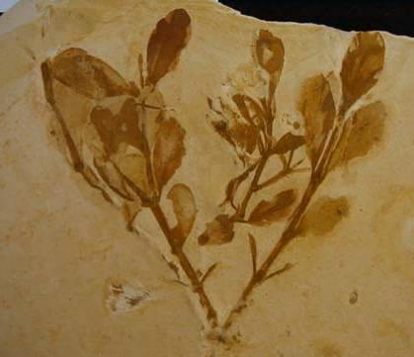

Slide 8
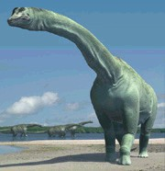
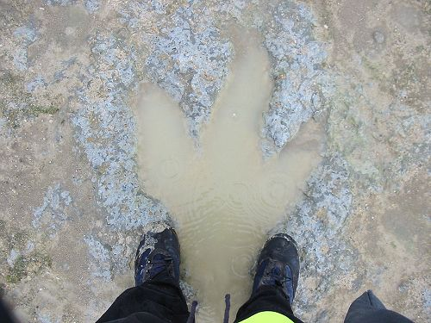
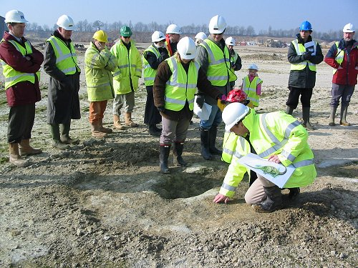

Slide 9
Calculating the Age of Fossils
Most fossils are found in sedimentary rock that was formed at the bottom of water.
Sediments are formed when water flows over land and wear away (erodes) the land.
These sediments then settle to the bottom of the river.
They eventually harden (due to the pressure on them) into rock.

Slide 10
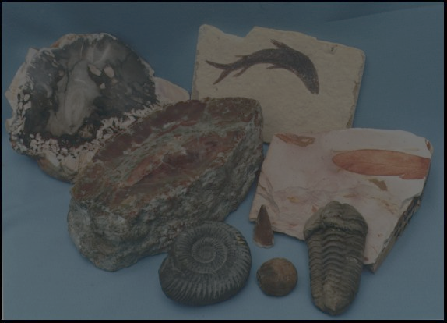
Law of Superposition: the higher up you go in an undisturbed rock stratum, the younger the rock layers become
** Upper, undisturbed strata generally contain fossils of more complex organisms, whereas, the lower strata contain fossils of simpler life forms. (Tendency toward increasing complexity over time.)
** When comparing fossils in undisturbed strata, fossils can be found in upper strata which, although different from fossils in lower strata, resemble those fossils. This suggests links between modern forms and older forms, as well as divergent pathways from common ancestors.

Slide 11
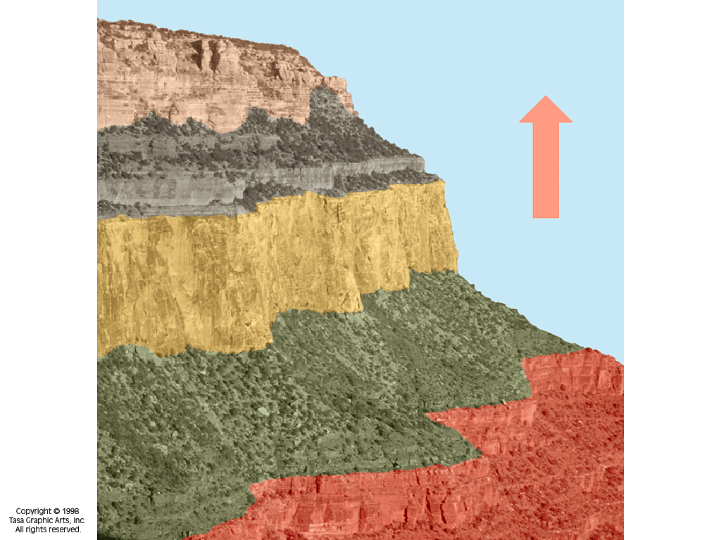
LAW OF SUPERPOSITION
YOUNGEST
TO
OLDEST

Slide 12
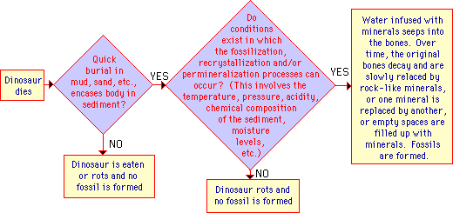

Slide 13
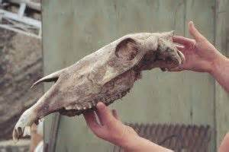
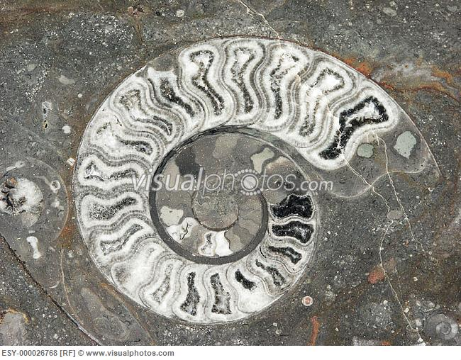
How to Date Fossils
Relative Dating - used to tell which of two fossils is older (looking at the rock layers)
2. Absolute Dating - measuring the radioactive elements in the fossils (gives an actual age)

Slide 14
Interpreting the fossil Record (Relative Dating)
Correlation – relating fossils to specific areas and rock layers
Index Fossils – fossils which existed in a relatively short period of time and over large area
Geologic Timetable – divides time into eons, eras, periods, and epochs

Slide 15
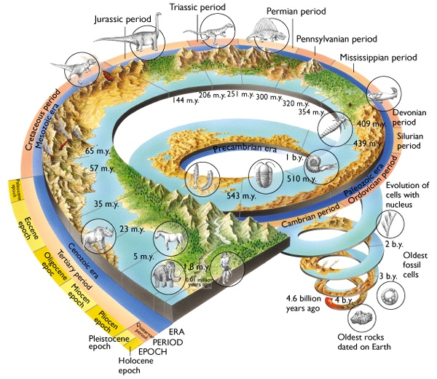

Slide 16
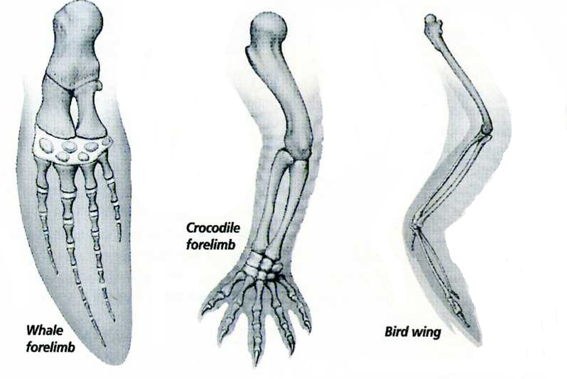
Evidence #2: Body Structure
Homologous structures: Body parts that are alike in structure or function because the species in question share a common ancestor.

Slide 17
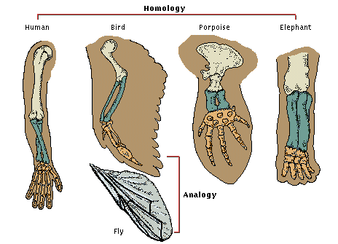
Analogous Structures
Structures with different structures but serve the same function.
Suggests different lines of evolution, meaning they came from MANY ORGANISMS!
  Ex: wing of an insect and the wing of a bird
    Both wings are used for flying, but they are made of completely different materials.

Slide 18
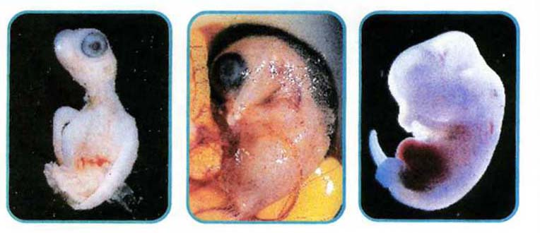
Evidence #3: Embryology
Related organisms resemble each other during embryology (formation of the embryo)

Slide 19
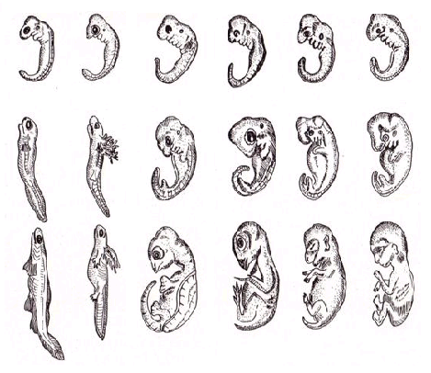
Comparative Embryology
Fish Salamander Tortoise Chick Calf Human

Slide 20
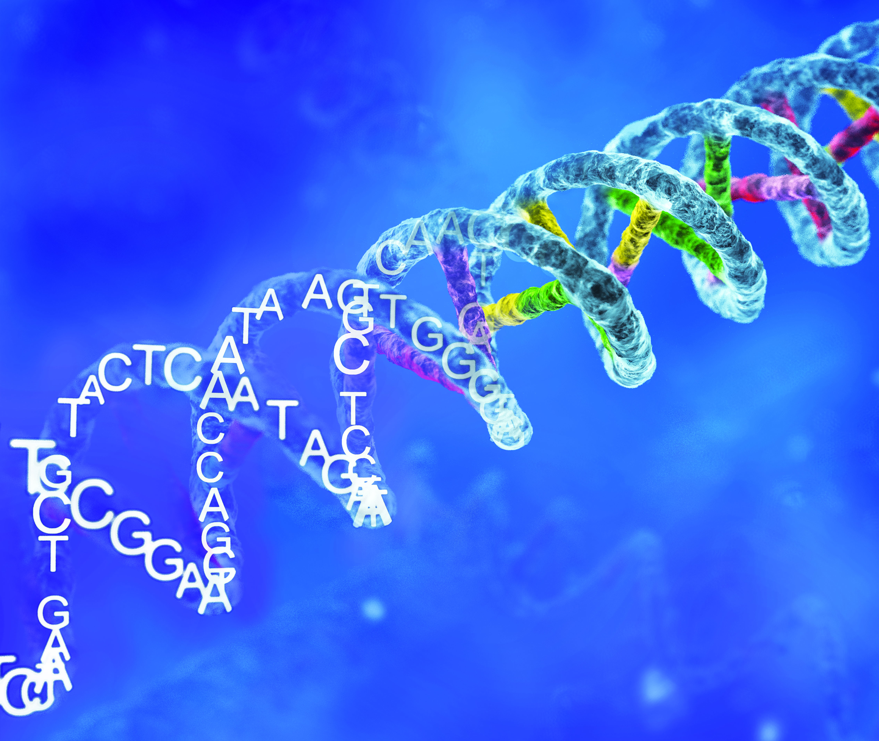
Evidence #4: Similarities in DNA
All organisms have the same four Nitrogenous Bases (A, T, G, C)
Proteins in all organisms are made from the same 20 amino acids

Slide 21
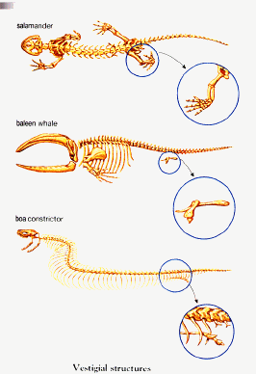
Evidence #5: Vestigial Structures
Remnants of structures that were in ancestral form.
Examples:
  whale pelvis
  tiny snake
  pelvic and limb bones
  the eyes in
  cave-dwelling salamanders
  and fish that are
  completely blind

Slide 22
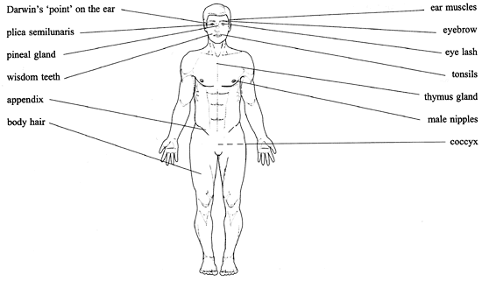
Vestigial Structures in Humans

Slide 23
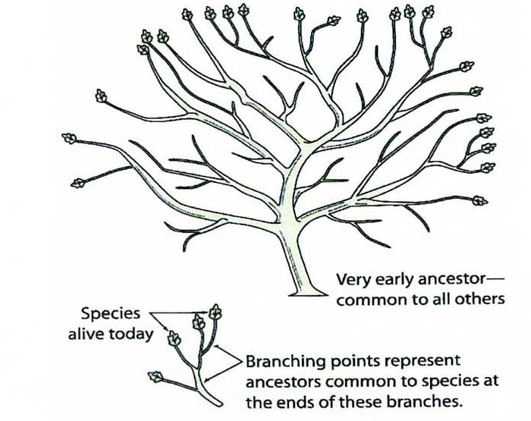
Showing Evolutionary Relationships

Slide 24
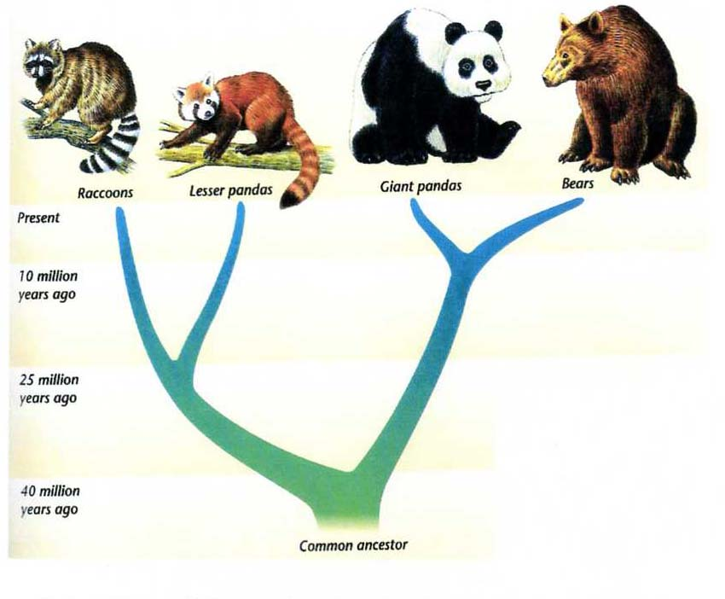
Scientists originally thought the Giant panda and the Lesser panda were closely related. Now, based on DNA evidence, they know Giant pandas are closer in relation to Bears.

Slide 25
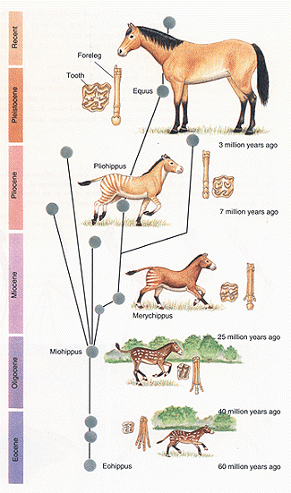

Slide 26
What is extinction?
Extinction: THE DISAPPEARANCE OF AN ENTIRE SPECIES
Extinction occurs when the DEATH RATE is greater than the BIRTH RATE within a given species.
Extinction is most likely to occur when there is a change to the environment
Examples: dramatic temperature changes, rise/fall of sea levels, grasslands become deserts, clear lakes become polluted, volcanic eruptions.

Slide 27
