Slide 1
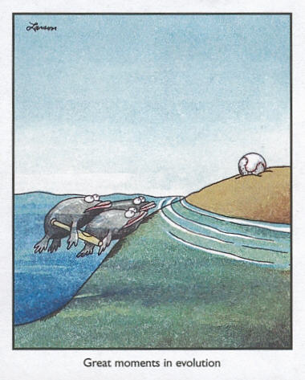
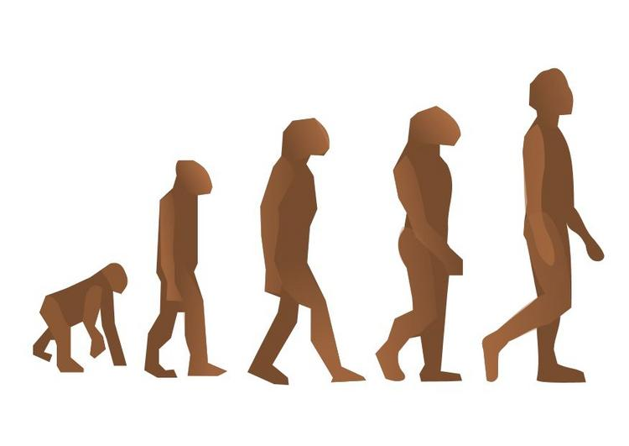

Slide 2
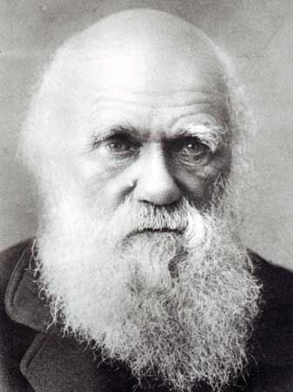
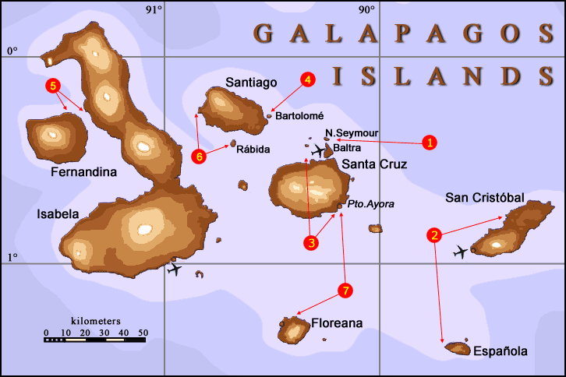
Charles Darwin and the Galapagos Islands (1835):
Darwin sailed from England to South America and then to the Galapagos Islands.
Darwin compared the species he observed in S. America to the species in the Galapagos. The differences between such similar species amazed him.
Charles Darwin
1809-1882
Also, within the Islands of the Galapagos, there was a great difference between species of different habitats (sea level vs. mountainous region).

Slide 3
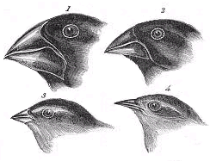
Darwin’s Finches
Observe the beaks of the Finches:
The beak of each finch is adapted to…
Birds that have a strong, wide beak are adapted for eating…
Birds that have a sharp, needlelike beak are adapted for eating…
The type of food the bird eats.
Seeds!
Insects!

Slide 4
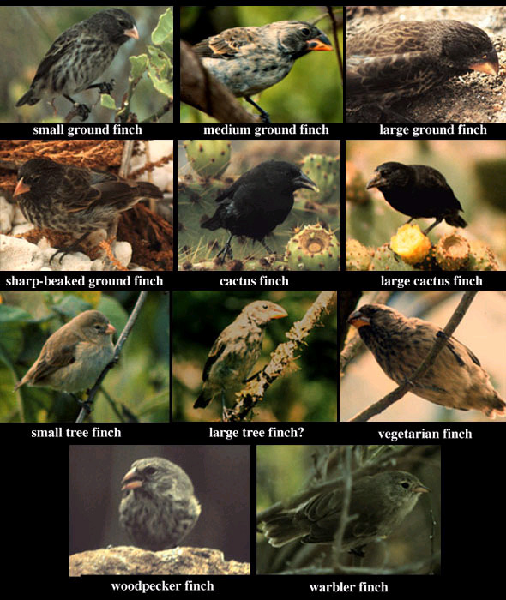

Slide 5
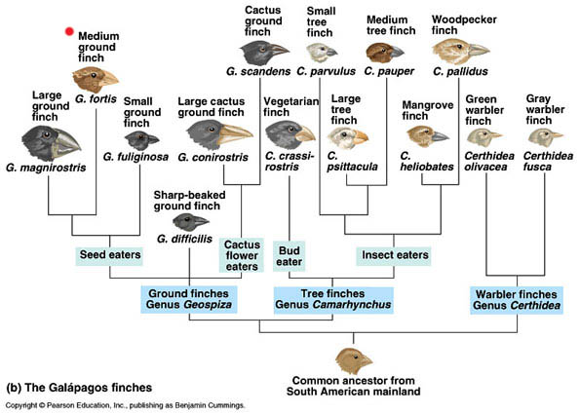

Slide 6
What is an adaptation?
An adaptation is a trait that helps an organism survive and reproduce.
It is also the evolution of a structure, behavior, or internal process that enables an organism to respond to environmental factors and live to produce offspring.

Slide 7
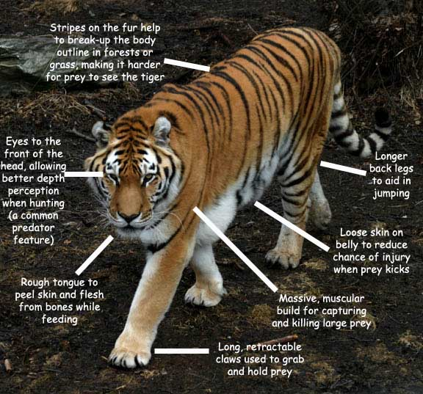

Slide 8
What did Darwin theorize?
Darwin returned to England and spent the next 20 years trying to figure out why there was such VARIATION among the species.
Darwin reasoned that animals/plants that arrived on one of the Galapagos Islands faced environmental conditions that were different from those on the mainland.
Darwin believed the species gradually changed over many generations and became better adapted to the new conditions.

Slide 9
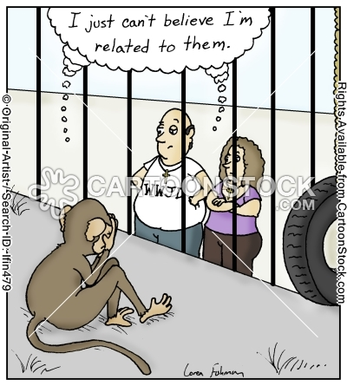
Theory of Evolution
Gradual change in a species through adaptations over time

Slide 10
So…How could this process of SELECTIVE BREEDING happen in nature?
NATURAL SELECTION:
The process by which individuals who are better adapted to their environment are more likely to survive than other members of the same species.

Slide 11
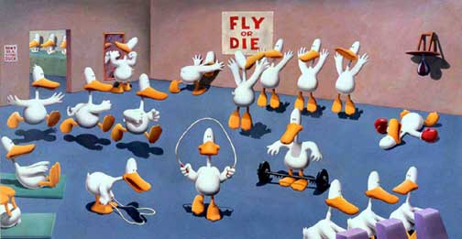
How does Natural Selection occur?
Survival of the Fittest: Individuals that are better suited for their environment survive and reproduce most successfully
Over time, natural selection results in changes in the inherited characteristics of a population. These changes increase a species’ fitness in its environment

Slide 12
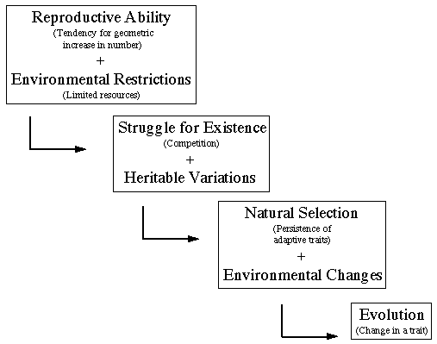

Slide 13
What affects natural selection?
The driving force behind evolution is the interactions between INDIVIDUALS and their ENVIRONMENT.
Darwin identified four factors that affect the process of natural selection: overproduction, competition, environmental conditions and variations among individuals…

Slide 14
1. Overproduction
Those species that produce many offspring guarantee that a few will survive to a reproductive age.
Overproduction is an adaptation for many species for survival.
Most species produce more offspring than can possibly survive
not enough resources available for all the species
many offspring die
Population remains the same as it was the previous year

Slide 15
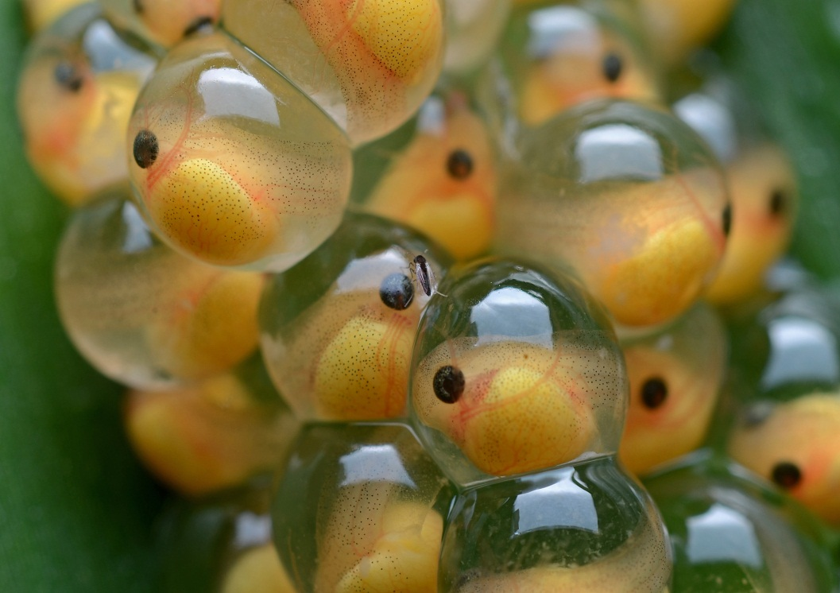
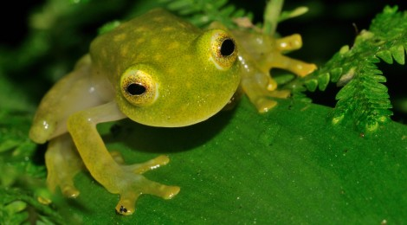
Example: Frogs lay a couple hundred eggs, but only a few (~1%) survive to reproduce their own offspring.

Slide 16
2. Competition
When food and other resources are limited, individuals must compete with others to survive.
The best competitors (fastest runner, strongest wings) will survive to produce offspring.
Those that are weak (unable to get food) will not survive to reproductive age.
“Survival of the Fittest”
Survival of the fittest ≠ Natural selection
can lead to

Slide 17
3. Environmental Conditions
When environmental conditions change, those species that are best adapted to the new environment will survive to reproduce.
Example: Peppered Moths of England during the Industrial Revolution.

Slide 18
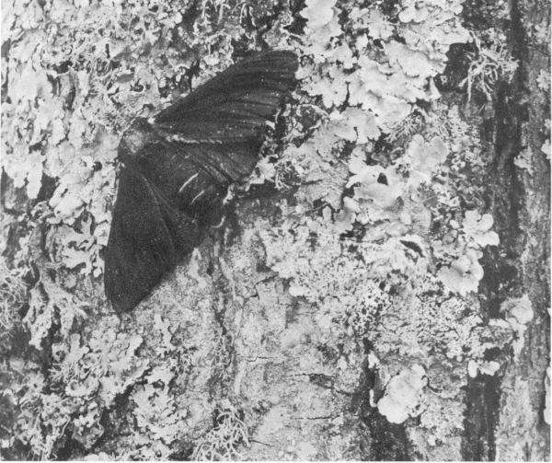
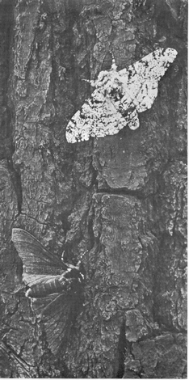
Before & After the Industrial Revolution
Pollution blackened the trunks of the trees and black moths became more likely to survive.

Slide 19
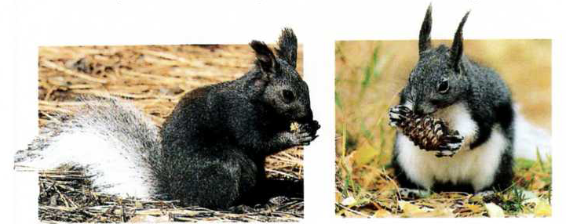
Kaibab Squirrel and Albert Squirrel
The species are believed to have been the same species thousands of years ago. When the Grand Canyon formed, it created a geographic barrier within the population. This eventually led the species to evolve, and now mating cannot occur between the two species.

